Slide 1

EECT 111 FINAL PROJECT
Circuit Analysis
Spring 2015
Cody Fletcher
May 7, 2015

Slide 2
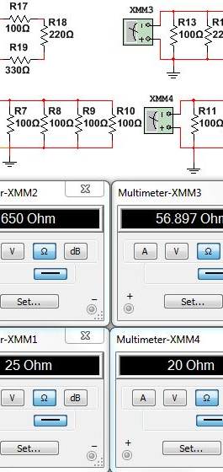
When combining Multiple resistors in series and Parallel several Rules apply in order to calculate the total resistance.
When combining multiple resistors in series, the total resistance is simply the sum of the resistors as measured by XMM2 in the figure to the right.. When combining in parallel, it depends on the number of resistors, and the whether or not those values are equal. In the circuit measured byXMM1, all three resistors are the same value, therefor, to calculate total resistance, simply take the resistor value and divide it by the total number of equal resistors. In the parallel circuit measured by XMM4, the resistor values are different, and there are only 2 resistors, total resistance is calculated by multiplying the two resistor values, and dividing that by the sum of the two resistor values. In the parallel circuit measured by XMM3, there are more than two resistors of different values, in order to calculate the total resistance each resistor values reciprocal is added together, and then the reciprocal of that value is equal to the total resistance.

Slide 3
Calculating Total Resistance, total current, total power, nodal voltages, branch currents, and power dissipation of a resistor circuit.
Finding the voltage and current over resistors in a complicated network is done using Ohm's Law, V=IR. Just as the battery voltage is the total current multiplied by the total equivalent resistance, so the voltage over any given resistor is the current through that resistor multiplied by its resistance. Consequently, to find the voltage over each resistor, you must first find the total current in the circuit, and then find the current through each branch. This can quickly become complicated for a network with anything but trivial complexity, so I will provide a detailed summary of the process with EXCEL in the next slide.
There are 4 main steps that need to be completed in order to perform these calculations.
Calculate each parallel element as one resistor, and then calculate total resistance.
Calculate the total current: I=V/R
Calculate the voltage over each equivalent resistor. This is the reason we reduced the parallel network components to equivalent resistors in series, because a series circuit has the same current throughout the circuit.
Once we have obtained the Voltage across each resistor, we can then calculate current and power dissipation.

Slide 4
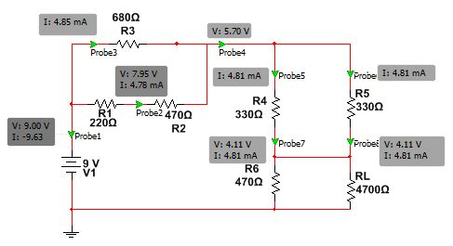
MultiSIM and EXCEL of a Complex Resistor Circuit

Slide 5
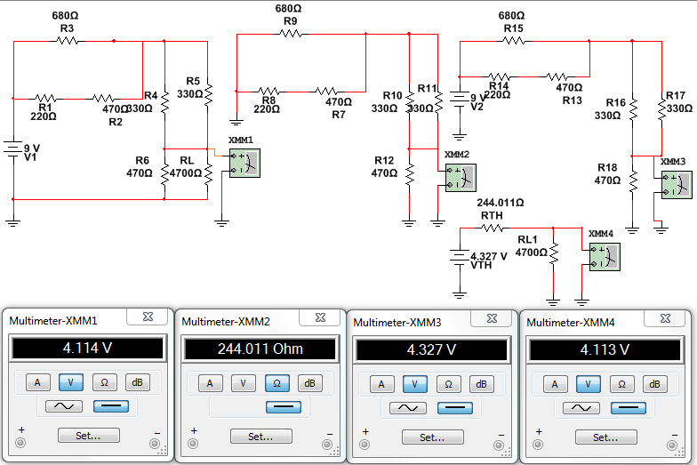
Thevenin Resistance and Voltage of A Resistor Circuit
The Thevenin-equivalent voltage is the voltage at the output terminals of the original circuit. When calculating a Thévenin-equivalent voltage, the voltage divider principle is useful, by declaring one terminal to be V_{out} and the other terminal to be at the ground point.
The Thevenin-equivalent resistance is measured across points A and B "looking back" into the circuit. It is important to first replace all voltage- and current-sources with their internal resistances. This includes replacing the voltage source with a short circuit. For an ideal current source, this means replacing the current source with an open circuit. Resistance can then be calculated across the terminals using the formula for series and parallel circuits.

